Slide 1
MARKETING & RETAIL ANALYTICS
CAPSTONE PROJECT
Submitted by :
Mithul Murugaadev

Slide 2
AGENDA
Background
Objective
Visualization and inferences
Insights
Recommendation
Appendix
1

Slide 3

Background
Olist is an E-commerce company that has faced losses recently. Their approach is to manage inventory efficiently and also to reduce additional costs.
Since the company serves a huge demand of products to its customers, there needs to be a better planning and organization of inventory.
Insights are needed for better inventory management.
2

Slide 4
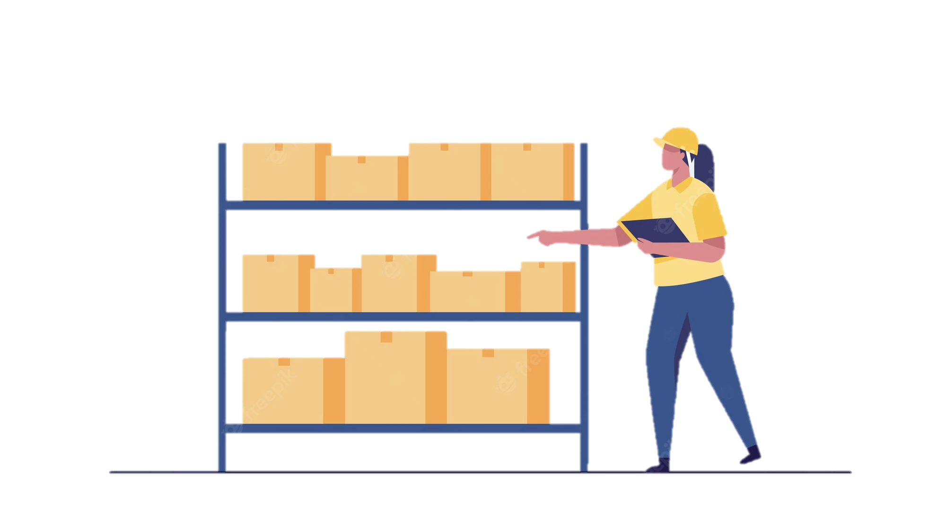
Objective
To understand the patterns of consumer behavior that can be taken advantage of cutting cost for the firm.
To identify the variety of products sold and its market demand.
To interpret efficient inventory management and planning for the company to reduce piling costs.
3

Slide 5

VISUALIZATION AND INFERENCES

Slide 6
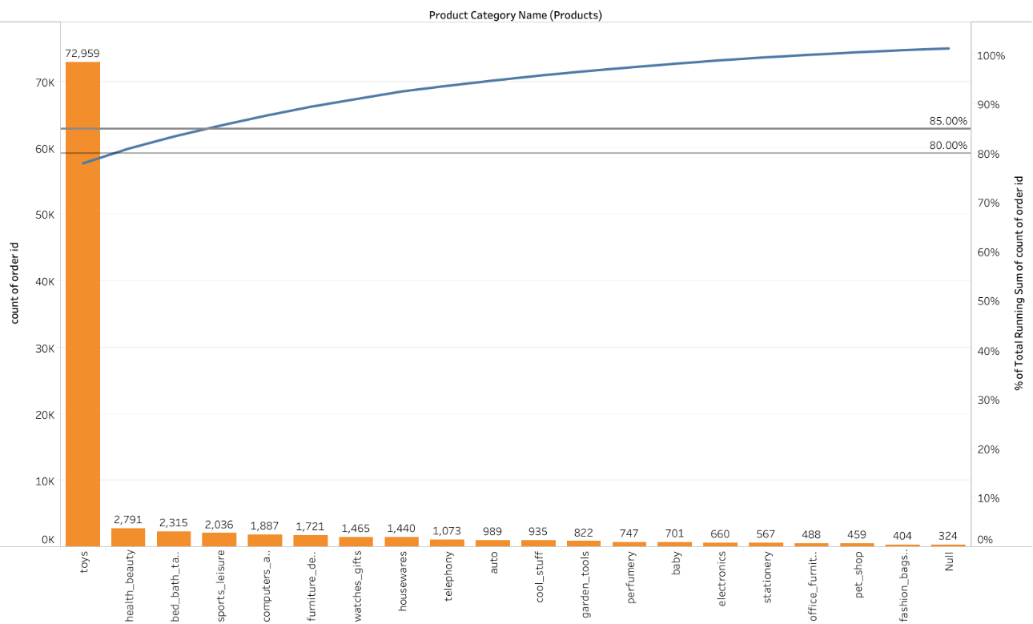

Toys marks the highest sold quantity
Toys, health and beauty and bed bath table alone comprise of 82% of the quantities sold.
Although toys alone contribute to a enormous no. of units sold, having 76% of the total sales.
In general, products related to leisure and comfort are sold often.
4

Slide 7
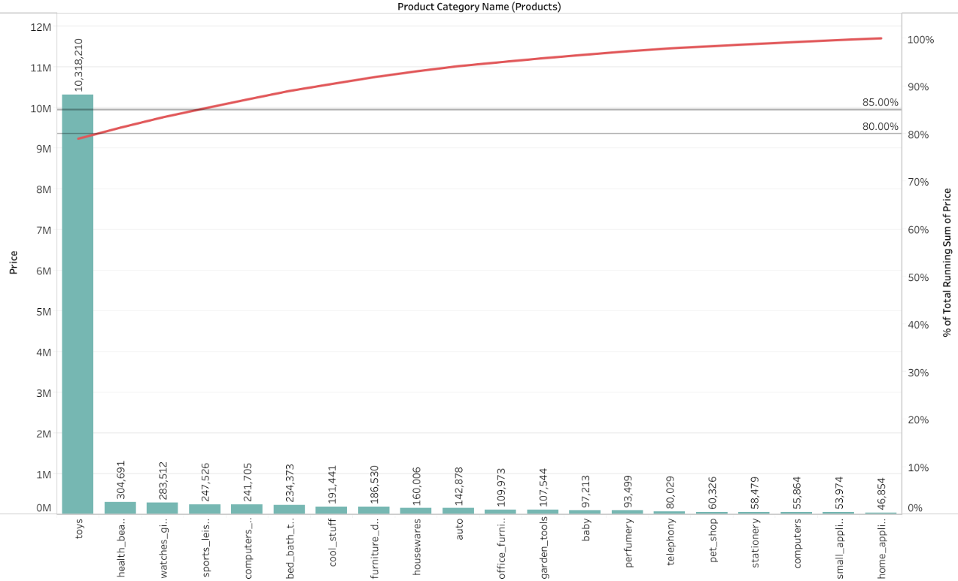

The higher the quantity, the higher the revenue
Toys, health and beauty and watches gifts contribute up to 81% of the revenue.
Although toys alone incorporates about 77% of the whole revenue.
Watch gifts - even though are comparatively is cheaper than most of the products, amounts to a larger quantity that are ordered.
5

Slide 8
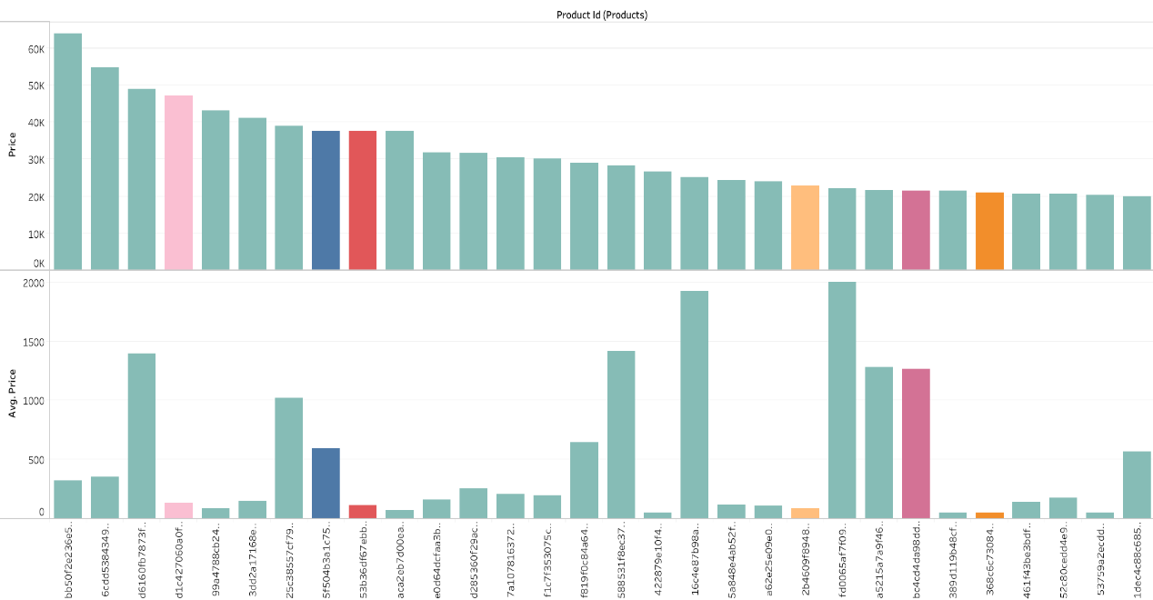
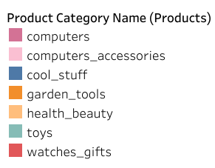
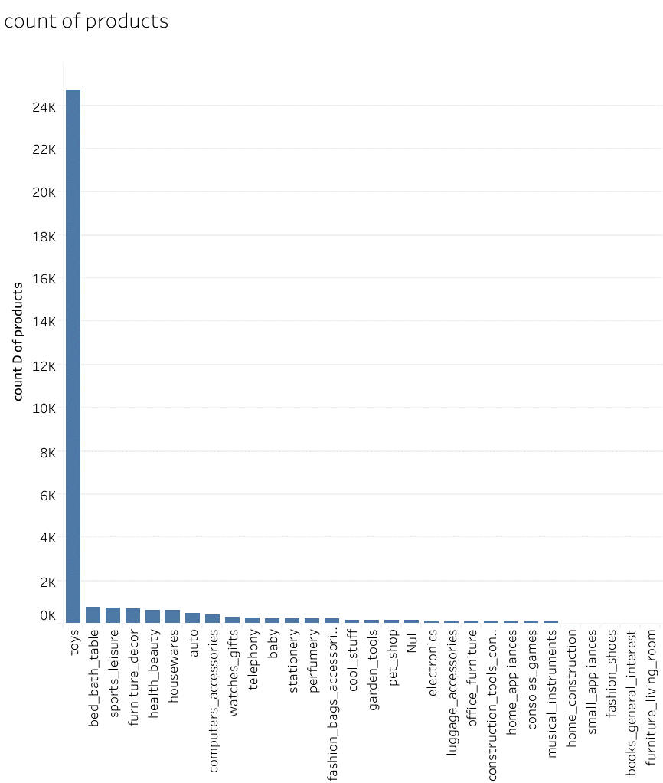
Pricey products makes notable bit in revenue
Along with toy products, computers and its accessories are granting a more distinguishable share to the revenue.
Computers and its accessories are costlier, thus smaller units bring on fair share in the revenue
There is a major variety of products in toys category.
6

Slide 9
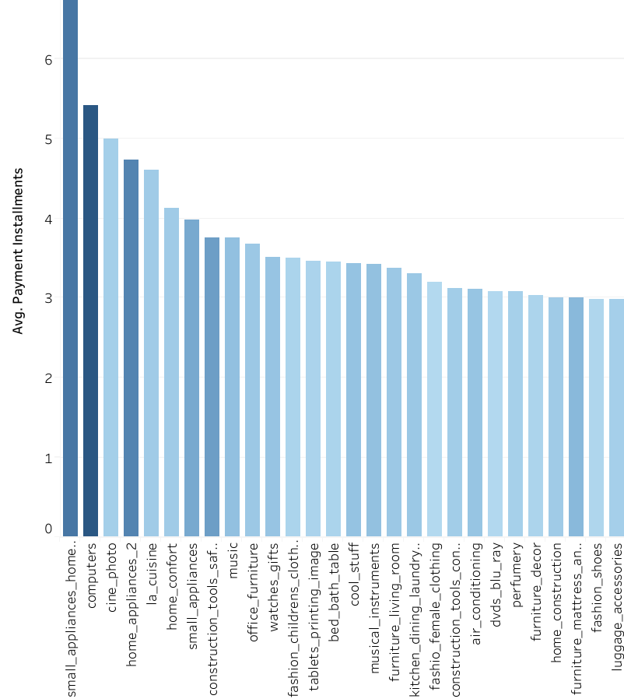
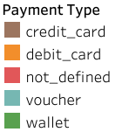
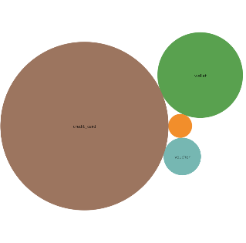

Enormous credit card users
Credit card is the most used method of payment, followed by a relatively smaller crowd preferring wallets.
Products related to home improvement like appliances, accessories and decor account to more no. of installments.
Computers, small appliances – comparatively costlier products are seen to have more no of installments.
7

Slide 10
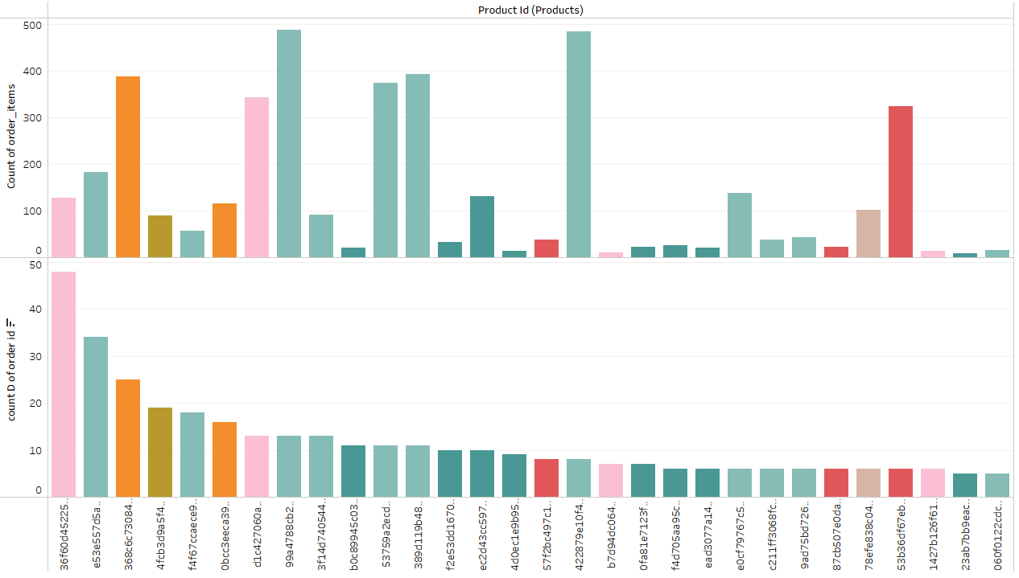
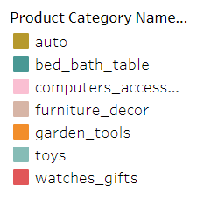
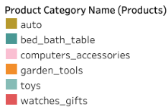
Chosen products preferred by recurring customers
There is wide spread of customers buying computer accessories, while there are repeating customers for toys.
Watches gifts are bought my repetitive customers. “53b36df67ebb7c41585e8d54d6772e08” – watch product has been sold more no. of units.
Toys are ordered the most. There are more units of the product sold to comparatively fewer group of customers.
The top bar chart shows the no of times that product is ordered.
The bottom graph shows the no. of customers ordering that product.
8

Slide 11
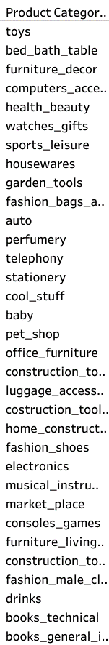
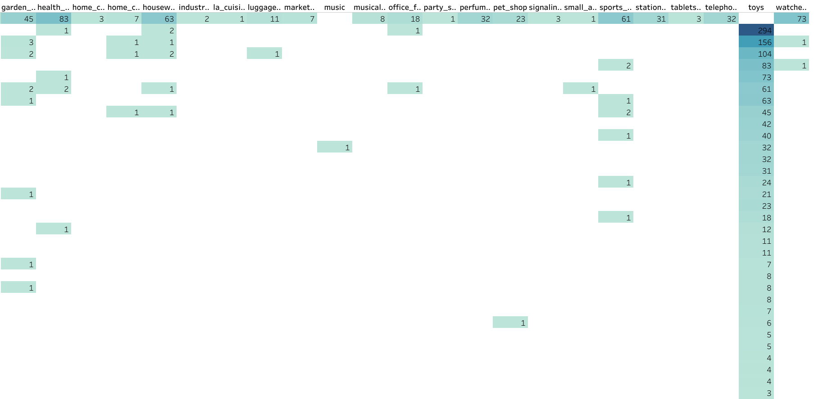
Most sold are also most bought together
Toys along with bed bath table has been ordered together most of the times, followed by furniture décor.
As seen in the 1st graph, toys and bed bath table comprises up to 80% approx. of units sold. These products also contribute to a fair share of the revenue(2nd graph)
Books are one of the least ordered even as individual products.
9

Slide 12
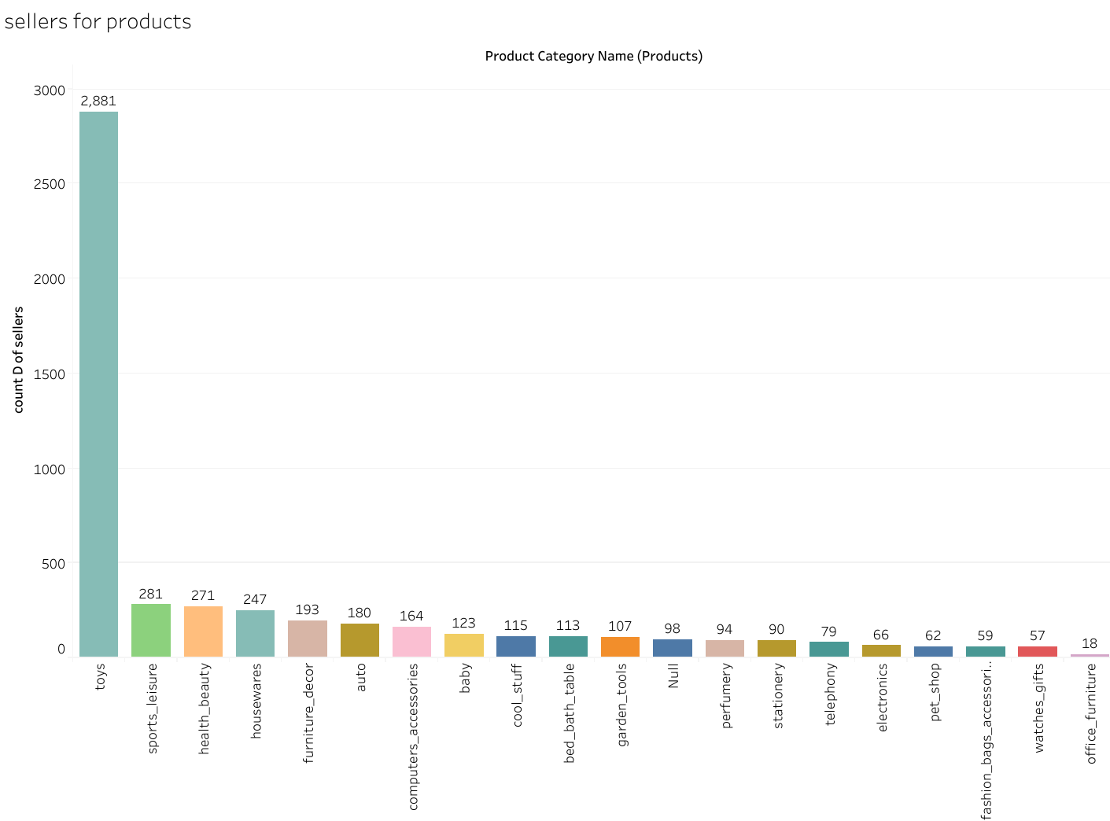
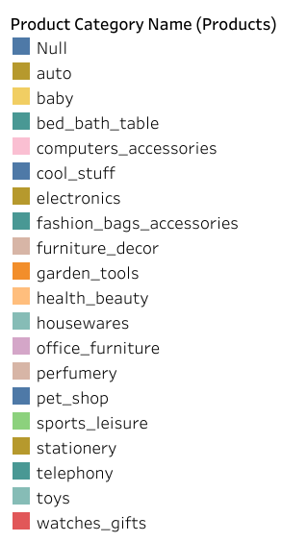
Most bought are also most available
Huge no. of sellers for toys.
Interestingly there are only few sellers for computers. But computer products have a fair share in revenue(3rd graph)
Very few sellers for flowers. Customers have very few options to buy the product.
10

Slide 13
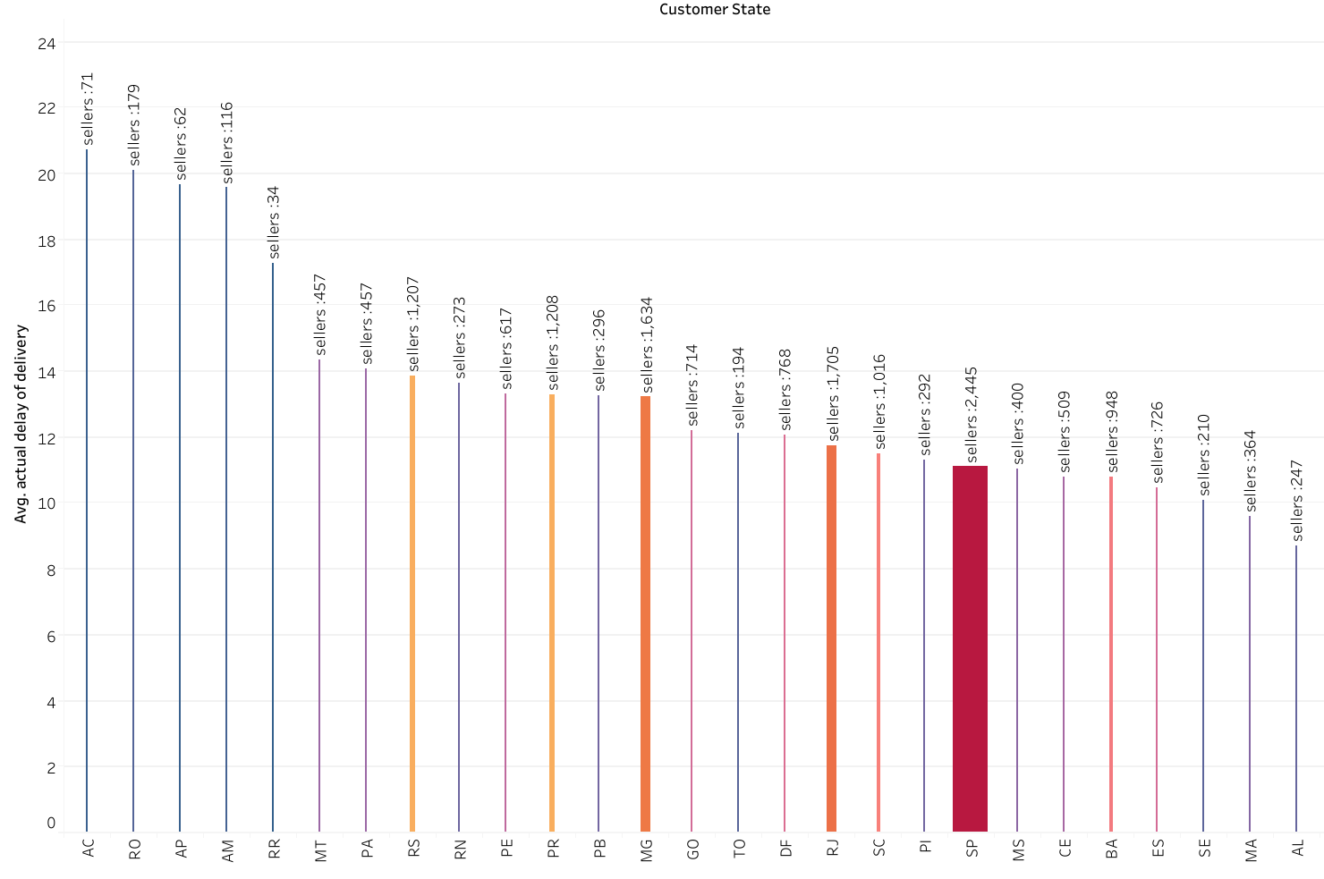
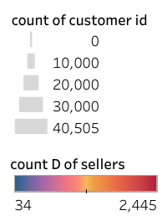
Supply attracts demand from customers
All the products are delivered well before the estimated date of arrival
When there are larger no of sellers present, there are also larger no. of customers present in the state.
SP state has the most no. of sellers and it also has a huge market of customers.
But as the demand increases, the delivery time decreases.
11

Slide 14
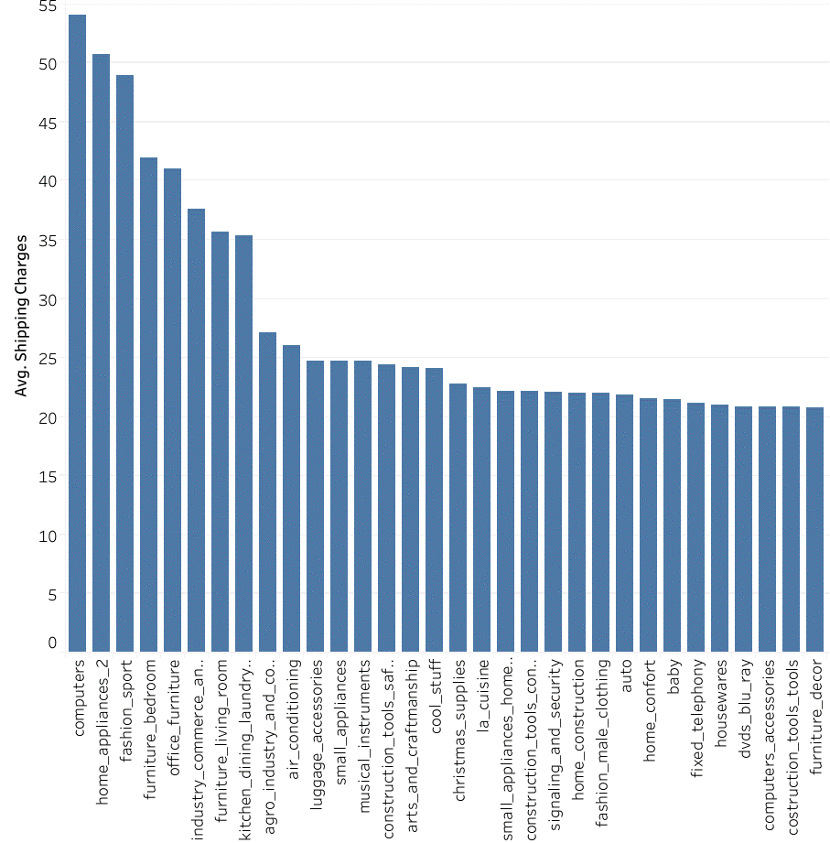
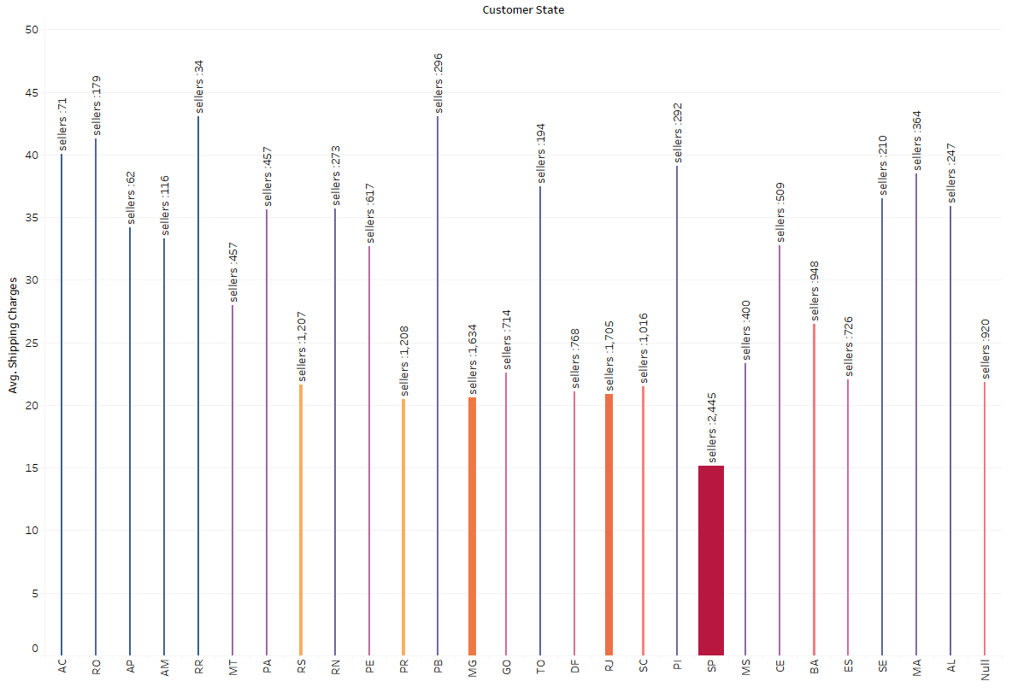
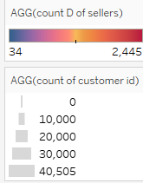
High priced and few local availability adds to the cost
Computers and home appliances incur larger shipping costs – costlier products incur more shipping charges.
(Right) Location having lesser no. of sellers are incurring more shipping charges.
12

Slide 15
Key insights
Toys, health and beauty are the most ordered product- contributes about 80% approx. of total units sold.
Toys have a large diversity of products.
“99a4788cb24856965c36a24e339b6058” (Toy) is the most sold commodity
“bb50f2e236e5eea0100680137654686c” (Toy) is the most profitable, as it has a higher price it shows a good inflow.
Computers and its accessories are usually mid priced – good inflow of revenue.
Most of the orders are delivered well before the estimated delivery.
Toys along with bed bath table or furniture décor has been bought together most of the times.
There is vast no. of sellers in the states that have more customer demand. The demand also shows slow delivery comparatively.
Costlier products have more installments for payment.
High-priced products incur higher shipping charges.
Credit card is the most preferred payment method followed by wallet by customers.
13

Slide 16
Recommendations
Toys are frequently bought.
“99a4788cb24856965c36a24e339b6058” can be promoted more.
Ensure more toy products are constantly stored in the inventory.
Toys has large variety of products, steps can be taken to diversify variety of products among other categories.
New sellers of the most sold and profitable products can be approached to ensure there is constant supply.
New sellers in the least catered states can be approached.
Toys and bed bath table or furniture décor, computer accessories are mostly bought together. Combo offers or suggestions among toy products can be provided.
Computer and its accessories are a source of higher revenue.
These products can be promoted more, making consumers aware that these products are available.
Since these are usually mid-priced, shipping charges can be discounted.
Watch gifts are mid priced products - good inflow of revenue. These products can be promoted.
Since credit card is the most preferred method, can look for introducing more credit card banking options.
14

Slide 17

Appendix – Data methodology
Given data is cleaned and modified through python in Jupyter notebook.
Extensive data analysis has been done on the given dataset with a primary focus on inventory management, cost cutting and opportunities on Increasing profit.
The cleaned dataset was imported on tableau for further analysis.
A new workbook was created for market basket analysis from the retail dataset.
The complete analysis was carried out on data containing order status as “delivered”.
Market basket analysis was performed in Tableau.
It is assumed that revenue is derived from price.
It is also assumed shipping charges is not a part of revenue.
Geospatial expansion of the company has been left out from the analysis scope.
Specific dashboards for different perspectives of the analysis is designed in tableau.
15

Slide 18
THANK YOU

